Slide 1
Blackjack and Machine Learning
Presented By:
Anir, Anthony, Chris, Dean, Delan, and Paula

Slide 2
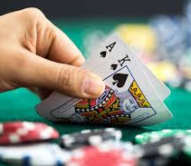
Winning Strategy
Is there a winning strategy?
There is none!
Rules support house edge by forcing players to act before dealer
Player’s enter “The Valley of Despair” when dealt a hand of 12 – 16
Machine learning methodologies can be used to used to identify the best possible strategy to minimize loss
Notes:
What is the winning strategy for blackjack? There is none!
Casino rules support the house gaining the edge by forcing players to act before the dealer, thus acting on incomplete information.
Players are especially in danger when their hands total between 12 and 16. They are at risk of busting with their next card, and the dealer is showing a high hand. Players call this the Valley of Despair.
Computer Scientist and Mathematicians have studied this game for many years to determine the best possible strategy to minimize loss, allowing a player to stretch his bankroll in hopes of hitting a lucky streak; however, you play long enough you will loss.
Many have attempted to identify the ‘players edge’ using machine methodologies such as generic algorithms, logistic regression, Reinforcement learning and neuro learning.

Slide 3
Objectives
Determine
Determine if card counting or standard play provide predictive betting patterns.
Simulate
Simulate 150,000 hands per 6 players to predict win/push/loss with a player hand of 12 and is it a viable strategy when compared to real data.
Examine
Examine the correlation of 2-card sum and final card sum by win/push/loss.
Determine
Determine the best seat position and the impact on player strategy.
Notes:
We decided to revisit Blackjack and do a deeper investigation of the data looking at player strategies such as counting cards, seat position and how potential strategies might impact the overall percentage of winning.
We wanted to investigate the “Valley of Despair” concept and if a winning strategy was to stay with a hand of 12. We built a Python simulator to test this strategy and compared it to the data collected.
We wanted to examine the correlation of 2-card sum and final card sum by win/push/loss.
And, lastly, we wanted to determine if there was a best seat position impacting player strategy.

Slide 4
How
Machine Learning
Logistic Regression
Linear Regression
Simulation
Python Pandas
Matplotlib
AWS – S3
ZEPL notebook

Slide 5

Logistic Regression
Predict chances of…
A player not going for a next bet based on card counting principles
A player winning a hand based on cards being dealt
Use regularization to tune data and compare results with co-relation derived from the same data set

Slide 6
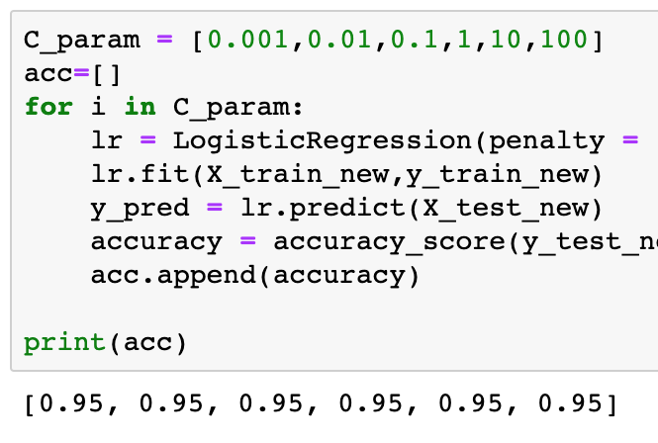
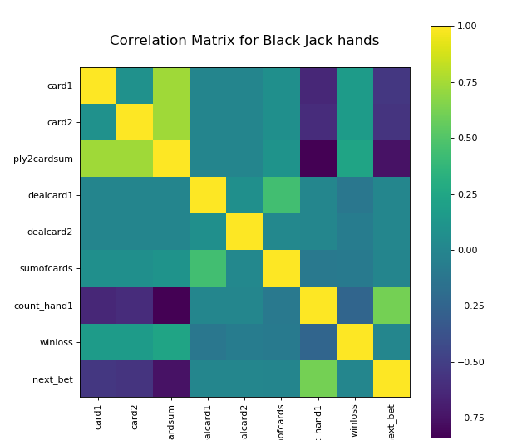
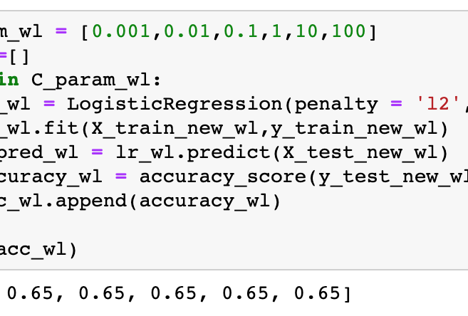

Slide 7
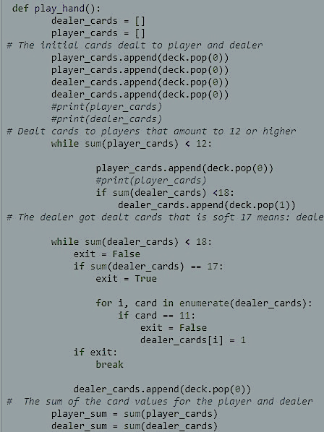
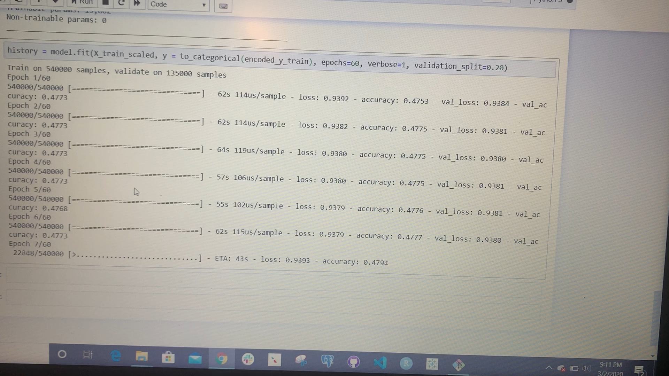
Python Blackjack Simulator
Play strategy
2-card Sum of 11: Hit once without busting, high possibility of blackjack
2-card Sum of 12: Hits increase chance of busting due to high number of face cards
Simulated play
Player stays at 12
Dealer plays until hard/soft 17 or higher
Simulated player response
Wins 46.15%
Pushes 6.16%
Losses 47.69%
Compared to Blackjack player data
Wins 32.17%
Pushes 5.71%
Losses 47.69%
Conclusion
Player loses in both scenarios
Factors
Player doesn’t buy into strategy
Player using different strategy
Notes:
The ultimate goal is for the dealer to bust and the player to stay or hit when appropriate ultimately extending their game play and hopefully winning more money.
We built a simulation in Python Pandas to test and lower the odds of busting by staying with a hand of 12. For the simulation there are 4 decks of cards totaling 208 cards shuffled randomly. The set value for face cards is 10 and the Ace is valued at 11 or 1.
With the 2-card sum of 11, the player can take another card without the risk of busting due to the highest non-interchangeable card having a value of 10. This hand has a high possibility of getting blackjack versus busting.
With a 2-card sum of 12, the player should stay. If he takes another card, there’s a high chance he will bust. If he stays, there’s a chance the dealer will bust because the dealer must have a hard 17 or hit until he reaches a soft 17. increasing the likelihood of the dealer busting.
900,000 simulations were run through the simulation producing random hands that resulted in 415,343 wins, 55,442 pushes, and 429,215 losses.
Therefore, when a player stays at 12, he has a 46.15% chance to win, a 6.16% chance for a push, and a 47.69% chance to lose.
We compared this with the blackjack data. When a player stayed at 12, he won 32.17% of the time, lost 62.11% of the time and pushed 5.71% of the time.
Based on this simulation in comparison to the data collected, even though the player still loses the majority of the time, staying at 12 minimizes that loss.

Slide 8
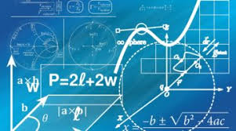
Linear Regression
Examine the correlation of 2-card sum and final card sum by win/push/loss
Model a relationship between initial hand value and ending hand value
Winning and losing hands modeled separately
Grouped winning and loosing hand counts by each value and compared against model prediction
Slight correlation between starting and ending hands, and no statistical correlation in hands player lost
Possible factor, different strategies applied by player based on situation
Both models average the predicted correlation compared to actual results
Notes:
This linear regression attempts to model a relationship between the value of the initial hand dealt with the ending hand value.
The eventual winning and losing hands were modeled separately.
The data used for this regression was loaded into a jupyter notebook file from AWS. Using Pandas, Matplotlib, and Scipy.stats to do the regression, I used a grouping of the winning and losing hand counts by each value to compare against what the model predicted.
The model shows a very slight correlation between the starting and ending hands and no statistical correlation in hands where the player lost.
I think this may be because of the different strategies applied by the player based on the situation they encounter.

Slide 9
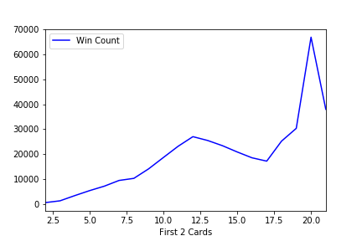
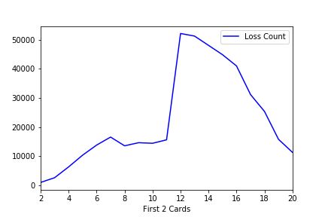
Notes:
Only one hand (in 900K) where the player got the maximum hits and only had total of 8. 12 players had 9 (4 winners were dealer busts).
12 – 16 and 20 make up 51% of starting hands
27% of wins end up with 18, 20, or 21
Initial values of 12 – 16 are statistically the worse hands with which to start

Slide 10
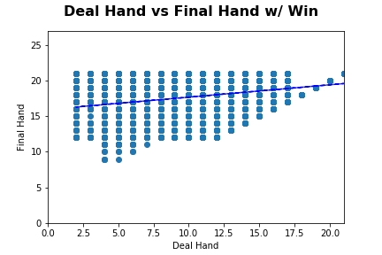
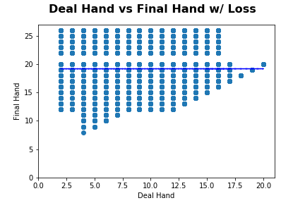
Notes:
Both models seem to average the predicted correlation compared to actual results.

Slide 11
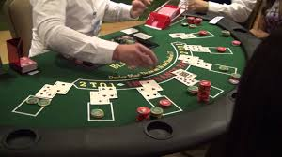
Blackjack Table Seat Position
Is there an advantage to seat position?
Player vs Dealer
Pack mentality dictates play strategy
Surroundings
Basic instincts
Competitive spirit
Counting cards
Expectation, Seats 1 and 6 as most winning seats
Theory tested
Seats assigned a value then ranked by wins and losses
Result
Based on data set, Seats 1 and 6 were the most winning seats.

Slide 12
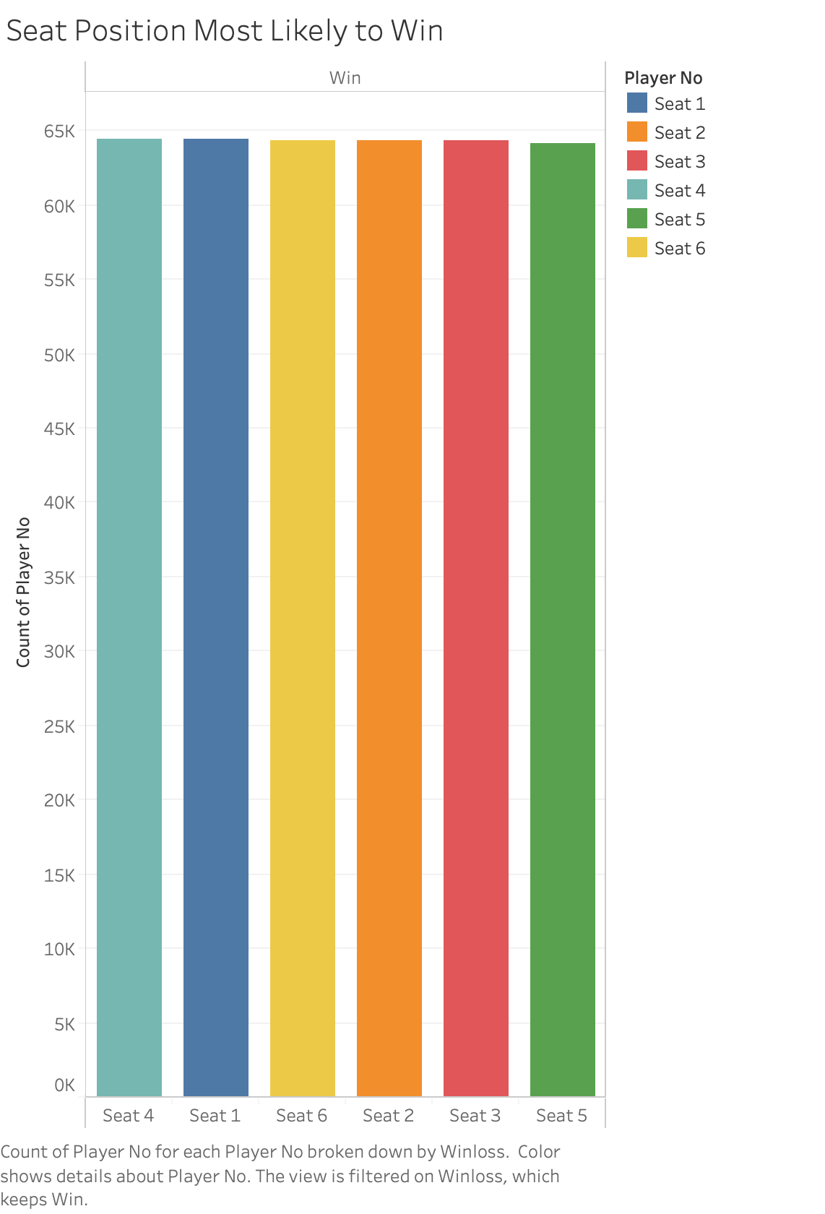
Seat Position Most Likely to Win
Seats descend in order 4, 1, 6, 2, 3, 5
Seat 4 scored the value 1 for the most wins at 64,421
Seat 5 scored the value 6 for the least wins at 64,106
Difference in wins
$10 Table: $3,150
$25 Table: $7,785

Slide 13
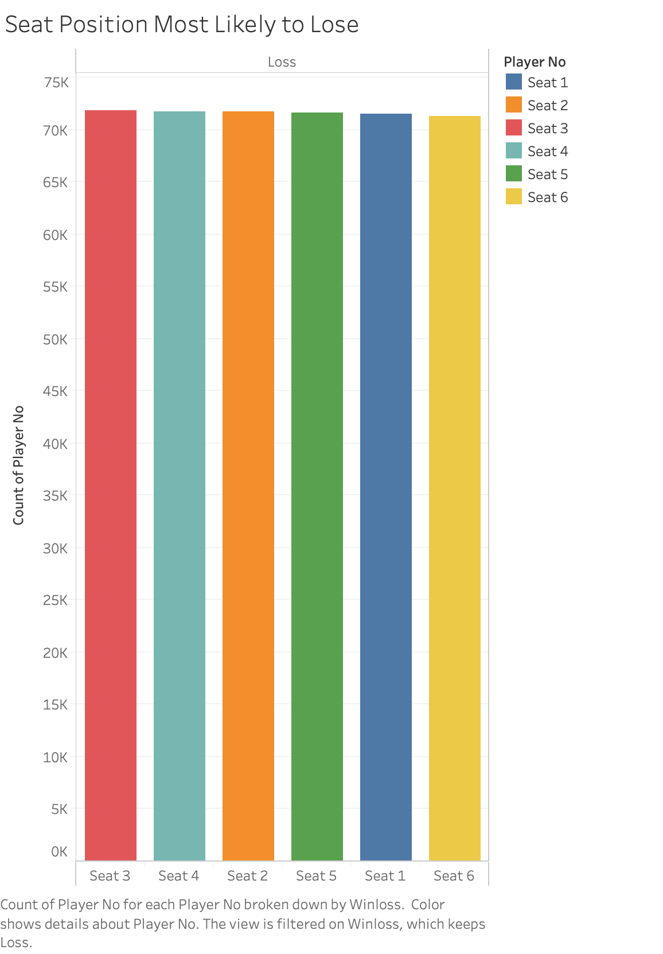
Seat Position Most Likely to Lose
Seats descend 3, 4, 2, 5, 1, 6
Seat 3 scored the value 1 for the most losses at 71,869
Seat 6 scored the value 6 for the least losses at 71,334
Difference in losses
$10 Table: $5,350
$25 Table: $13,375

Slide 14
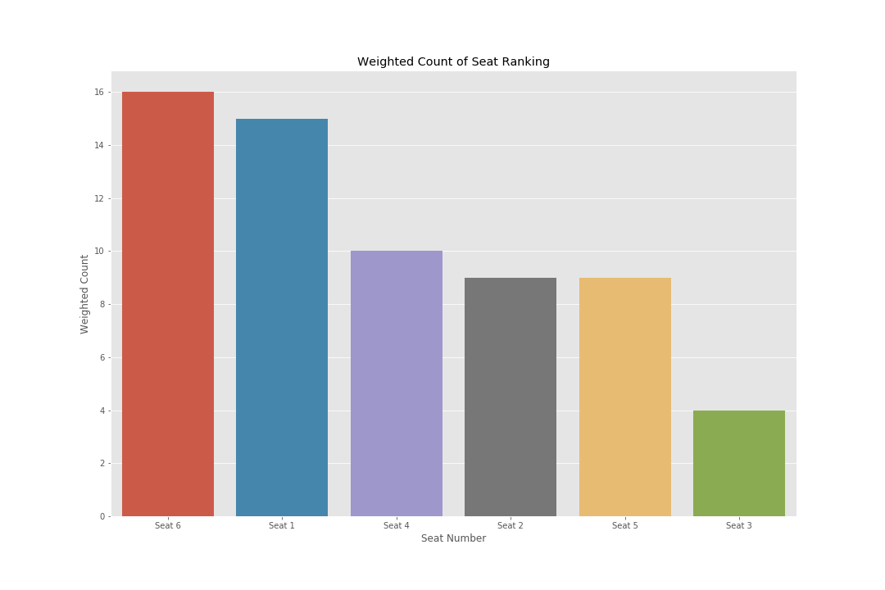
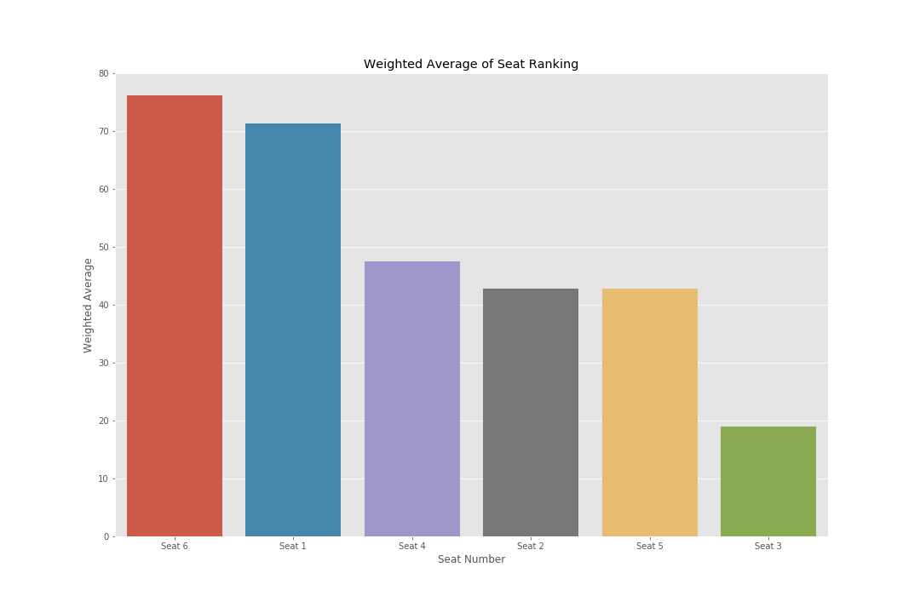

Slide 15
The End
Now, let’s head to the Casino!
Notes:
What is the winning strategy for blackjack? There is none!
Casino rules support the house gaining the edge by forcing players to act before the dealer, thus acting on incomplete information.
Players are especially in danger when their hands total between 12 and 16. They are at risk of busting with their next card, and the dealer is showing a high hand. Players call this the Valley of Despair.
Computer Scientist and Mathematicians have studied this game for many years to determine the best possible strategy to minimize loss, allowing a player to stretch his bankroll in hopes of hitting a lucky streak; however, you play long enough you will loss.
Many have attempted to identify the ‘players edge’ using machine methodologies such as generic algorithms, logistic regression, Reinforcement learning and neuro learning.

